Slide 1
Understanding Widgets in Flutter
Stateless vs. Stateful Widgets
Week 01 – Day 06

Slide 2
Introduction to Flutter Widgets
Flutter is a UI toolkit for building natively compiled applications for mobile, web, and desktop from a single codebase.
In Flutter, everything is a widget, which are the building blocks of a Flutter app’s user interface.
There are two types of widgets: Stateless and Stateful

Slide 3
Stateless Widgets
Stateless widgets are immutable, meaning their properties cannot change—all values are final.
They are ideal for static content that does not require updates once rendered.
Example: A text label or an icon.

Slide 4
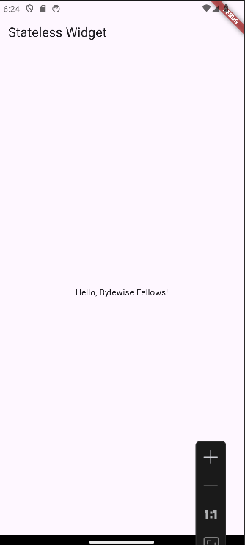
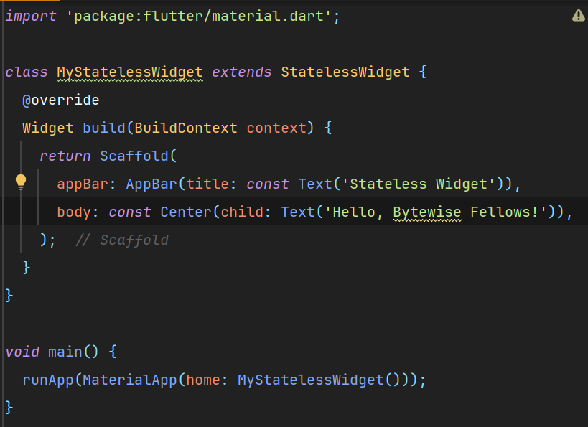
Stateless Widget Code Example

Slide 5
Stateful Widgets
Stateful widgets maintain a state that might change during the lifetime of the widget.
They are ideal for dynamic content that can update in response to user interactions or other events.
Example: A counter that increments when a button is pressed.

Slide 6
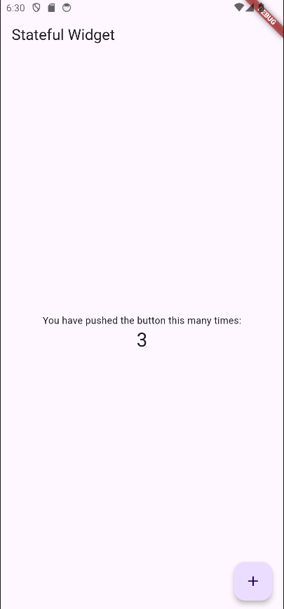
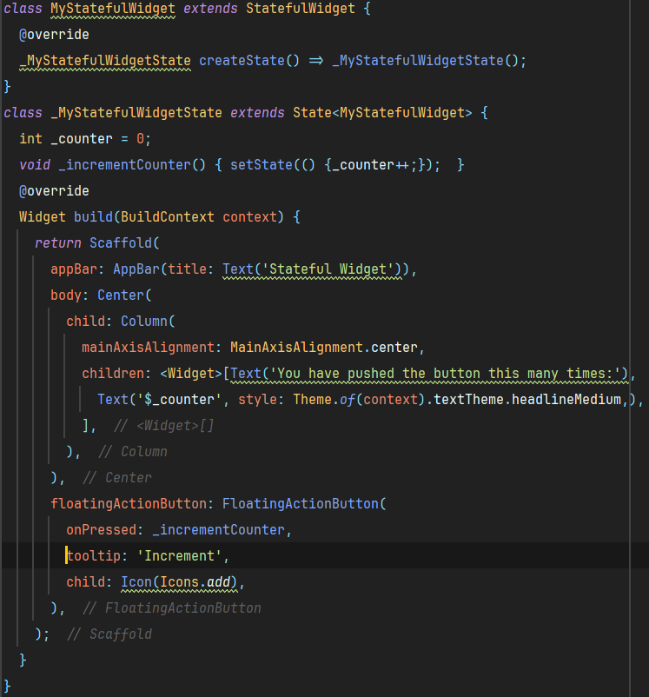
Stateful Widget Code Example

Slide 7
Life Cycle of Stateful Widgets
createState(): Called when the framework creates a StatefulWidget.
initState(): Called once when the state is created.
didChangeDependencies(): Called when a dependency of the State object changes.
build(): Describes the part of the user interface represented by the widget.
setState(): Notifies the framework that the state has changed, triggering a rebuild.
deactivate(): Called when the state is removed from the tree temporarily.
dispose(): Called when the state is permanently removed from the tree.

Slide 8
Hot Reload vs. Restart
Hot Reload:
Quickly compiles code changes and injects them into the running Dart VM.
Preserves the state of the app.
Ideal for rapid iteration.
Hot Restart:
Completely restarts the app.
All state is lost.
Useful for deep changes like altering the main function or state initialization.

